Slide 1

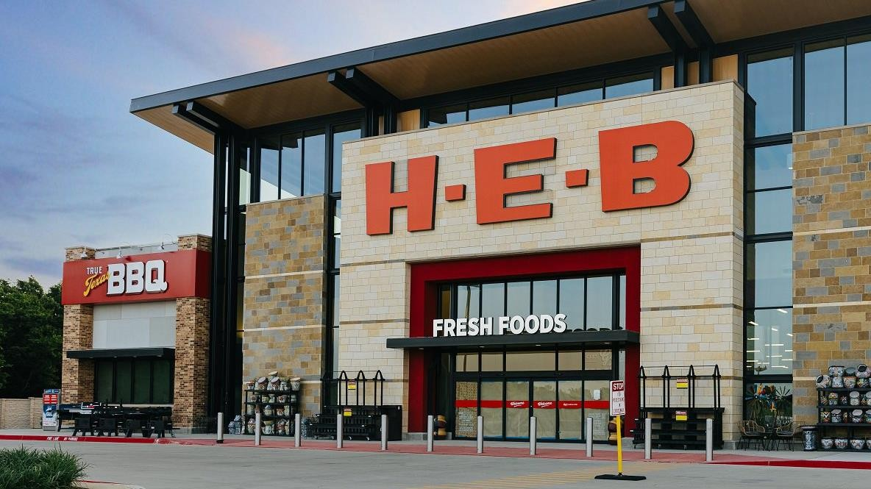

Weekly Status Report
Cost, Supplier, Pricing, Wentworth, Location,
Pharmacy, GSS and PAM HEBXXX-SUST-0002-00
11 July, 2025
PROPRIETARY & CONFIDENTIAL © G10X (2025) HEBXXX-SUST-0002-00

Slide 2

Index
TABLE OF CONTENTS
03 Cost Core Service CHEDR (Haskell) | 04 Supplier Core Service QA and SPUR (Haskell) | 07 Pricing Core Service (Haskell and Java)
08 Wentworth (Haskell) | 09 Location Core Service (Java and Angular) | 10 Pharmacy and Wellness (iOS and QA)
12 Global Sourcing Solution | 13 Product Attribute Management (QA) | 14 LoCo (BSA)
15 Matters of Attention | 15 Team Allocation

Slide 3
Delivery Status – Cost Core Service
Highlights of week ending July 11, 2025 | Overall status
 | Last Week | This Week
Sprint – 文言-lang, Ended (June 25 – July 08) Stories (Total – 11, Completed – 10, In-Review – 1) Current week sprint status Stories completed this week – 6 stories Convert Location Group and Friends to Int32 Expand DSD ledger cache to all stores and push to the data lake Set up cron job that runs daily at 6AM Investigate missing ledgers in BI Figure out how to get BDM code in our system Research to design approach send AR invoices and balancing report to PeopleSoft Stories released for Partner review – 1 story Push list-cost impact and proposed tobacco rebate data to BI as part of CCR topic Sprint – XigXag , In-progress(July 09 – July 22) Stories (Total – 4, In-Review – 1, In-progress – 3) Current week sprint status Stories released for Partner review – 1 story Push list-cost impact and proposed tobacco rebate data to BI as part of CCR topic Stories in-progress this week – 3 stories Improve traceability of ledger cache messages Support partner decisions for Supplier Level Deals Investigate Future cost emitter crashes due to deal location key decode error
Key activities for next week
Investigate Future cost emitter crashes due to deal location key decode error Improve traceability of ledger cache messages Support partner decisions for Supplier Level Deals

Slide 4
Delivery Status – Supplier Core Service
Highlights of week ending July 11, 2025 | Overall status
 | Last Week | This Week
SPUR Sprint – T, Ended (June 26 – July 10) Stories (Total – 8, Completed – 1, In-review – 5, In-progress – 2) Current week sprint status: Stories completed this week – 1 story Increase the limit of report generation for 100 days Stories released for Partner review – 5 stories Move SIDM forwarder service from CX to KP cluster Create endpoint to resend failed SIDM messages Setup Datadog events and alerts on IRS 4xx and 5xx responses Create endpoint to list expiring COI Documents Add endpoints and Patch validations for international tax classification type rules Stories in-progress this week – 2 stories Implement Pause functionality in Report generation Add discarded changes line in audit report Sprint – U, In-Progress (July 10 – July 24) Stories (Total – 8, Completed – 1, In-review – 5, In-progress – 2) Current week sprint status: Stories completed this week – 1 story Setup Datadog events and alerts on IRS 4xx and 5xx responses Stories released for Partner review – 5 stories Move SIDM forwarder service from CX to KP cluster Create endpoint to resend failed SIDM messages Create endpoint to list expiring COI Documents Add endpoints and Patch validations for international tax classification type rules

Slide 5
Delivery Status – Supplier Core Service (Contd..)
Highlights of week ending July 11, 2025 | Overall status
 | Last Week | This Week
In CSV indexes, add filtering on 'Invited by User' field Stories in-progress this week – 2 stories Implement Pause functionality in Report generation Add discarded changes line in audit report Supplier Portal – QA Sprint – F, In-Progress (July 07 – July 25) Stories (Total – 23, Completed – 7, In-progress – 16) Current week sprint status: Stories completed this week – 7 stories Validated creation of resale supplier template on proxy admin form using provided document Validated remit address section updated on proxy form with new field and text changes Validated supplier maintenance approval email sent to supplier account admin and alternate after post-AP approval Validated realigned invite form fields to match proxy form layout Validated resale invite workflow with regression smoke testing covering template, submission, emails, data save, status updates, edits, and uninvite actions Validated resale invite overview not loading if stores or warehouses not selected Validated proxy form updated with new company info fields and SPUR save integration Stories in-progress this week – 16 stories Validating resale supplier receives approval email when approved by SMT team Validating required COI and Shipping Document fields show on resale supplier form as per conditions Validating buyer sees only relevant sections and actions on overview based on assignment Validating buyer access to supplier tables with correct views and limited actions Validating inviter access to supplier tables with correct views and actions only on pending invites Validating resale supplier can submit post-approval changes for SMT review Validating SMT user sees resale suppliers ready for review in approvals table with filters working

Slide 6
Delivery Status – Supplier Core Service (Contd..)
Highlights of week ending July 11, 2025 | Overall status
 | Last Week | This Week
Validating SMT user views all resale supplier details in overview, regression works as today Validating SMT user approves or requests changes on resale supplier, regression passes Validating resale supplier receives request changes email from SMT as per existing design Validating resale supplier receives email when SMT approves registration updates Validating resale supplier gets email when buyer requests changes Validating auto-filter on supplier tables by role: BDA by creator, BDM by sub-dept, SMT sees all Validating base invite form updated with all resale fields, logic, and role access for SupplierRegLead/Base Validating UI-only base invite form updates with all resale fields, tooltips, excluding ack fields, save, and SPUR-driven options Validating sending of secondary payment email to SPUR in new secondary Email field; SPUR will combine with primary
Key activities for next week
SPUR Add discarded changes line in audit report Implement Pause functionality in Report generation Supplier Portal – QA Focusing on completing the functional stories currently in QA

Slide 7
Delivery Status – Pricing Core Service
Highlights of week ending July 11, 2025 | Overall status
 | Last Week | This Week
Sprint – Quiche, In-progress (July 03 – July 18) Stories (Total – 6, Completed – 1, In-review – 4, In-progress – 1) Current week sprint status: Stories completed this week – 1 story Create Triggerable Job to re-emit full schedules in assortment to a given topic Stories released for Partner review – 4 stories Experiment with queues instead of work-tables for PPUPC Generate Avro schema from our Price Schedule message object eComm Recalculator - Introduce unit testing framework which includes mocking and good assertion practice PCS - address all Semgrep CVEs for our code. Stories released for in-progress – 1 story PCS - Client library - Price Schedules - Java Spring Boot - Pub/Sub
Key activities for next week
Write client libraries for pcs consumers

Slide 8
Delivery Status – Wentworth
Highlights of week ending July 11, 2025 | Overall status
 | Last Week | This Week
Current week status (July 07 – July 11) Stories (Total – 2, Completed – 1, In-progress – 1) Stories completed this week – 1 story Add functionality to order inbound orders using gate out time as requested by the Hivemind team Stories in-progress this week – 1 story Format and prettify full query golden test files
Key activities for next week
Learn more about Apollo GraphOS Format and prettify full query golden test files Attend Wentworth Q4 planning

Slide 9
Delivery Status – Location Core Service
Highlights of week ending July 11, 2025 | Overall status
 | Last Week | This Week
Sprint – Donkey, Ended (June 27 – July 10) Stories (Total – 9, Completed – 9) Stories completed this week – 9 stories Integrate tracking of building feature events in Amplitude for Loco UI (Analytics) Integrate tracking of global search feature events in Amplitude for Loco UI (Analytics) Integrate tracking of campus feature events in Amplitude for Loco UI (Analytics) Update amplitude naming for fam-app (Analytics) Integrate tracking of location 101 feature events in Amplitude for Loco UI (Analytics) Implement user behavioral alerts on amplitude (Analytics) Integrate map on land details page in Loco UI (UI) Loco API changes to adapt to streaming file upload (Backend) Updated Land creation stepper component (UI) Sprint – EVA(Wall-E), In-progress (July 11 – July 24) Stories (Total – 3, In-progress – 3) Stories in-progress this week – 3 stories Retry failed upload in file upload implementation (UI) File upload component implementation (UI) Establish Web Socket Communication with LocationHQ (UI / Backend)
Key activities for next week
Retry failed upload in file upload implementation (UI) File upload component implementation (UI) Establish Web Socket Communication with LocationHQ (Backend)

Slide 10
Delivery Status – Pharmacy and Wellness
Highlights of week ending July 11, 2025 | Overall status
 | Last Week | This Week
Sprint – CRx Engineers 6/23 - 7/7, Ended (June 23 – July 7) Stories (Total – 29, Completed – 21, In-review – 6, In-progress – 2) Current week sprint status: Stories released for Partner review – 6 stories Validated the ‘Barcode Scanning’ during ‘Manual Refill’ in Android Validated the ‘Manual Refill Review Screen’ for ‘Compound Rx’ on Web Validated the ‘Time Picker’ for ‘Compound and Regular’ refillable prescriptions on Web Validated the 'Push Notification' functionality in 'Pharmacy Setting' screen in Android Validated the 'CPRE' submission in 'Manual Refill' in Android Validated the 'Metadata' for 'Specialty and Compound' prescription in Android Stories in-progress this week – 2 stories Validate the error functionality for ‘Declined’ payment methods in the ‘Prepay checkout’ screen in iOS Validate the 'Manual Refill' in 'Unrefillable ' prescription in Android Sprint – CRx Engineers 7/7 - 7/21, In-progress (July 7 – July 21) Stories (Total – 15, Completed – 2, In-review – 8, In-progress – 5) Current week sprint status: Stories completed this week – 2 stories Validated the ‘Manual Refill Review Screen’ for ‘Compound Rx’ on Web Validated the ‘Time Picker’ for ‘Compound and Regular’ refillable prescriptions on Web Stories released for Partner review – 8 stories Validated the ‘Barcode Scanning’ during ‘Manual Refill’ in Android Validated the content update in the ‘Communication preferences edit’ screen and ‘Delivery contact’ screen iOS Validated the content update in the ‘Language preferences’ screen in iOS Validated the 'Push Notification' functionality in 'Pharmacy Setting' screen in Android Validated the 'CPRE' submission in 'Manual Refill' in Android Validated the 'Metadata' for 'Specialty and Compound' prescription in Android Validated the 'Manual Refill' in 'Unrefillable ' prescription in Android

Slide 11
Delivery Status – Pharmacy and Wellness (Contd…)
Highlights of week ending July 11, 2025 | Overall status
 | Last Week | This Week
Validated the display of '3 Button Menu' overlaps with "Checkout" button in Android Stories in-progress this week – 5 stories Validate the 'Manual Refill – Refill review and confirmation’ screen in Android Validate the ‘Signature modal’ on ‘Order details page’ on Web Validate the ‘Compound Refill Confirmation’ screen in iOS Validate the ‘Change Ready time’ screen for ‘Refill prescriptions’ in iOS Validate the display of 'Spinner' when submitting the 'Refill Review' in Android Bugs reported this week – 2 bugs User is unable to add signature from order details page on Web User unable to hits the submit button without signing in the add signature page on Web
Key activities for next week
Test 'Manual Refill' in Android and ‘Signature modal’ on ‘Order details page’ on Web Test the ‘Change Ready time’ screen for ‘Refill prescriptions’ in iOS Test the display of 'Spinner' when submitting the 'Refill Review' in Android

Slide 12
Delivery Status – Global Sourcing Solution
Highlights of week ending July 11, 2025 | Overall status
 | Last Week | This Week
Sprint – GSS, In-Progress (June 30 – July 14) Stories (Total – 5, Completed – 5) Current week sprint status: Stories completed this week – 3 stories Customs compliance not able to change tariff description on some quotes Export button from the Quotes search page not working Sample tag for MRTs should show the freight cost for the item unit rather than entire MRT
Key activities for next week
Complete Datadog setup on all servers

Slide 13
Delivery Status – Product Attribute Management
Highlights of week ending July 11, 2025 | Overall status
 | Last Week | This Week
Sprint – PAM – Armadillo – (25Q3 SP4), Ended (June 25 – July 08) Functionalities/Stories (Total – 31, Completed – 31) Current week status: Functionalities completed this week – 1 functionality Test execution – MRT product setup – Add individual UPC Sprint – PAM – (25Q3 SP5), In-progress (July 09 – July 22) Functionalities/Stories (Total – 6, Completed – 5, In-progress – 1) Current week status: Functionalities completed this week – 5 functionalities Test execution – MRT product setup – Add individual UPC – Create candidate Test execution – MRT product setup – UPCs – UPC list – MRT summary Test execution – MRT product setup – UPCs – UPC list – Table Test execution – MRT product setup – UPCs – UPC list – options Test execution – MRT product setup – UPCs – UPC list – activation and validation Functionalities in-progress this week – 1 functionality Test execution – MRT product setup – Case – Navigation and HEB details
Key activities for next week
Test execution for MRT

Slide 14
Delivery Status – BSA (LoCo)
Highlights of week ending Jul 04, 2025 | Overall status
 | Last Week | This Week
Current week status (Jun 07 - Jul 11) Quarterly planning prep Lucernex documentation for Q4 deliverables Presented Store Master findings
Key activities for next week
Quarterly planning Q4 Sprint planning

Slide 15
Matters of Attention | Overall status
 | Last Week | This Week
None to Report
Team Allocation
# | Name | Skillset | Track | Billable Count
1 | Karthic Kumar | Haskell | Supplier Core Service | 2
2 | Akash Verma
3 | Rishi Manoj | Haskell | Cost Core Service | 4
4 | Arjun P Khandkar
5 | Althaf Hussain
6 | SparshTandon
7 | Nishant Kaushik | Haskell | Wentworth | 1
8 | Vijai Krishna | Haskell | Pricing Core Service | 1
9 | Imthiyaz A S | QA Automation | Supplier Portal | 2
10 | Balu S Kumar
11 | Vineed Kaladharan | AngularJS | Location Core Service | 3
12 | Noblevincent Vincent | Java
13 | Vignesh Krishnan
14 | Arshana Kizhakkiniyakath | QA | Pharmacy & Wellness | 3
15 | Remya Karuppayil
16 | Gisha Sankaran
17 | Kumar K Singh | AngularJS | Own Brand Product System | 1
18 | Vinu Lalitha | QA | Product Attribute Management | 1
19 | Sifat Billah Chowdhury | BSA | All COST Services / Locations | 1
20 | Shivaraj Kumarappa | Delivery Lead | All Tracks | 1
Total |  |  |  | 20

Slide 16


WWW.G10X.COM
G10X Inc.
7545 Irvine Center Drive Irvine, California
USA
G10X Technology Pvt Ltd. Brigade World Trade Center Infopark, Cochin
India
G10X Pvt Ltd.
Berkeley Square House London, W1J 6BD
UK
G10X GmbH
Mergenthalerallee 10 Eschborn, Frankfurt
Germany
G10X PTE Ltd.
Prudential Tower Singapore 049712
Singapore
G10X DMCC
Gold Tower DMCC, Dubai
UAE
PROPRIETARY & CONFIDENTIAL © G10X (2025) HEBXXX-SUST-0002-00

